Slide 1





ADVANCED
Airbnb has a Chinese name: 爱彼迎 (Aibiying)
DATABASE MANAGEMENT
PROJECT
A deep dive into Airbnb’s Dallas Dataset using advanced SQL queries
PRESENTED BY : GROUP 6
CHAITANYA BURRI
YU-HUI LIN
ABHISHEK KROVVIDI
MADHUR KHANNA
DURGA DASH

Slide 2



PROBLEM
STATEMENT
Airbnb once sold cereal
Perform Exploratory Data Analysis (EDA) on the Airbnb Dallas dataset to derive actionable business insights to guide strategic decision-making.
Some key questions that are investigated include:
Who are highly rated hosts?
How much did hosts earn from their listings?

Slide 3




ABOUT
THE DATASET
Business information on hosts, guests, and properties in Dallas
200,000+ Reviews
5,600+ Listings
2,500+ Hosts
Time scope: 2010 - 2023
The “AIR” in airbnb comes from Air Mattress which the founders had put on rent for their first hosts.

Slide 4
AIRBNB IS ACTIVE IN EVERY SINGLE COUNTRY ON THE PLANET EXCEPT FOR IRAN, SUDAN, SYRIA, AND NORTH KOREA. THAT’S 97.95% OF THE WORLD
DATABASE DESIGN
GUESTS-REVIEWS (ONE TO MANY)
LISTINGS-REVIEWS (ONE TO MANY)
LISTINGS-ROOM TYPES (MANY TO ONE)
LISTINGS-PROPERTY TYPES (MANY TO ONE)
LISTINGS-NEIGHBORHOODS (MANY TO ONE)
HOSTS-LISTINGS (ONE TO MANY)
Guests
Hosts
||
||
Property Types
|<
||
Reviews
|<
Neighborhoods
||
||
Listings
Room Types
|<
||

Slide 5
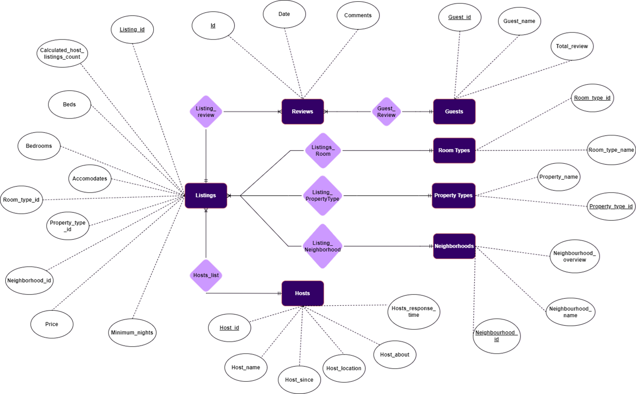

Slide 6
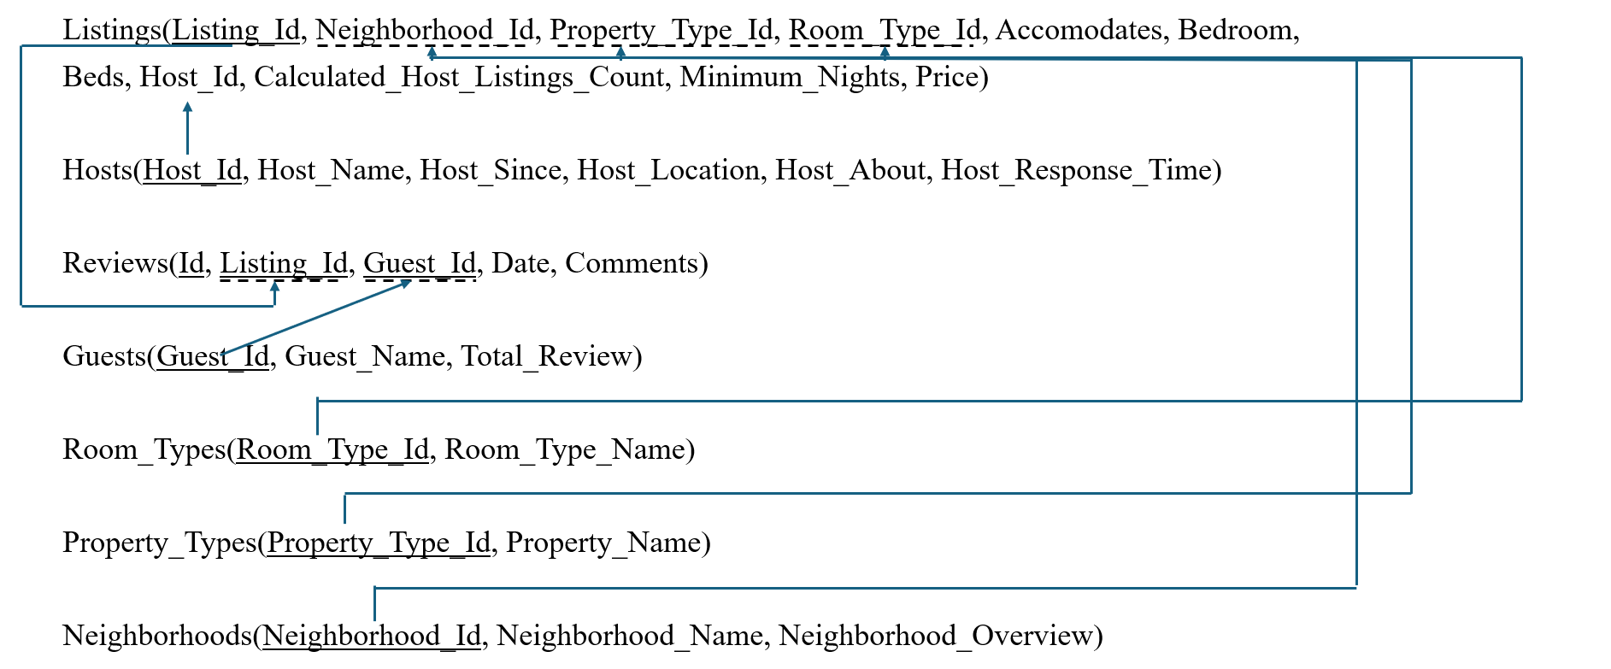

RELATIONAL SCHEMA

Slide 7
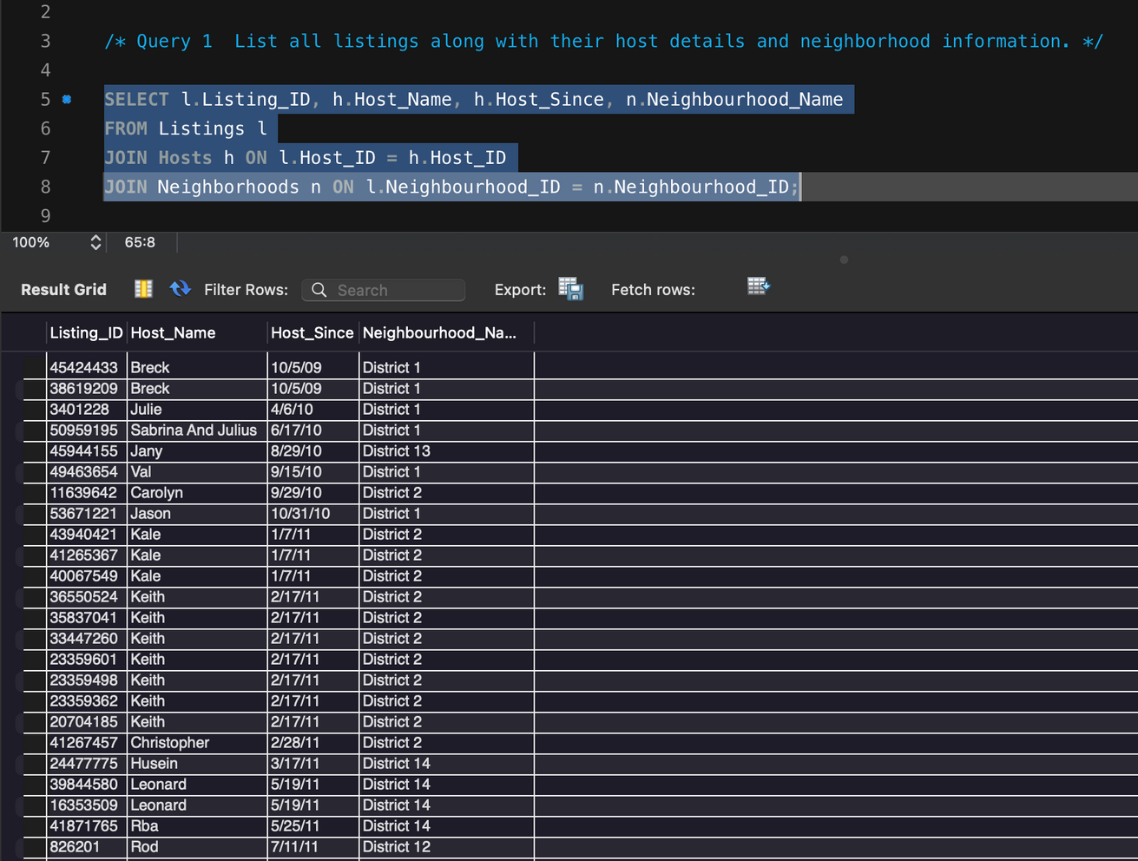
BUSINESS QUESTION 1
Display all the listings along with their host details and neighborhood information.

Slide 8
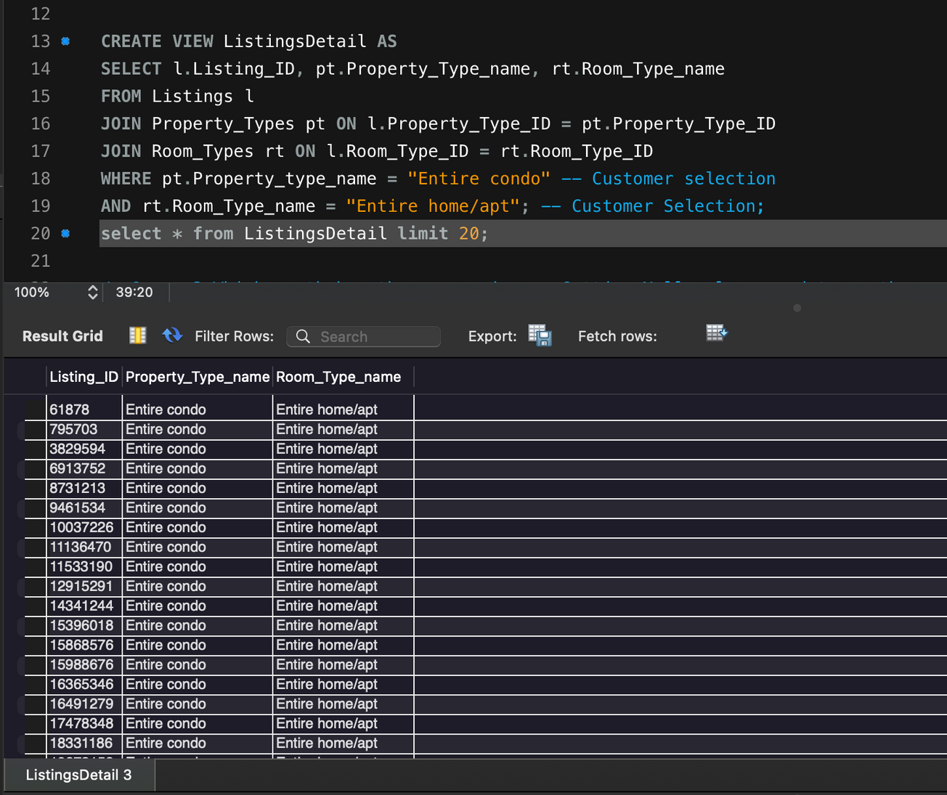
BUSINESS QUESTION 2
Create a view to show listings with their property and room types.

Slide 9
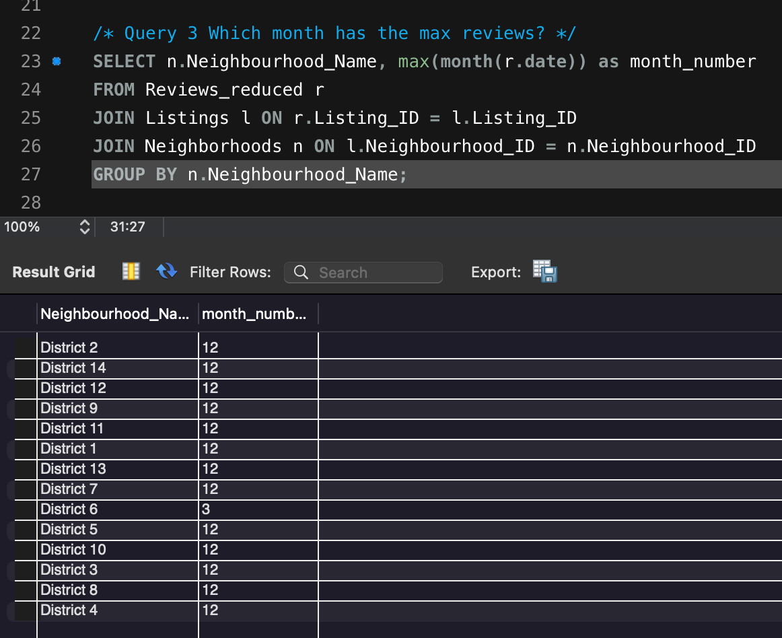
BUSINESS QUESTION 3
Which month has the highest number of reviews for each neighborhood?

Slide 10
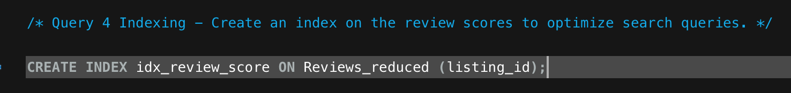
BUSINESS QUESTION 4
Create an index on the review scores to optimize search queries.

Slide 11
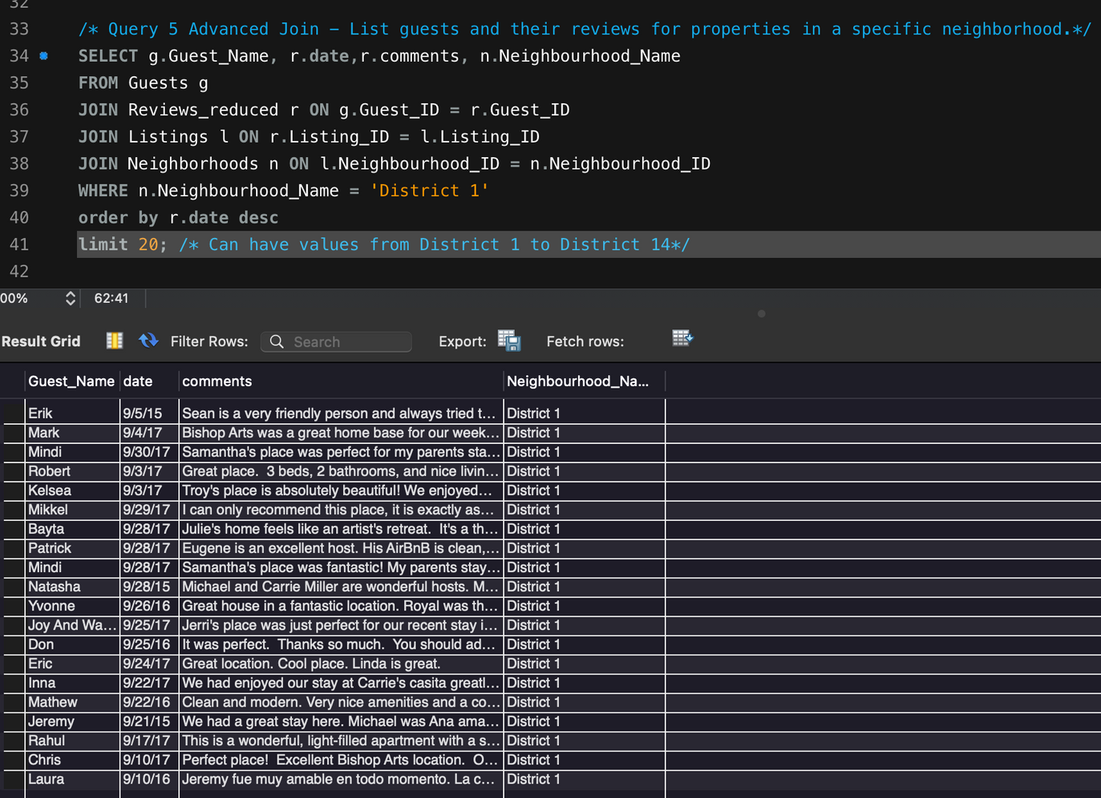
BUSINESS QUESTION 5
List the guests and their reviews for a user selected district.

Slide 12
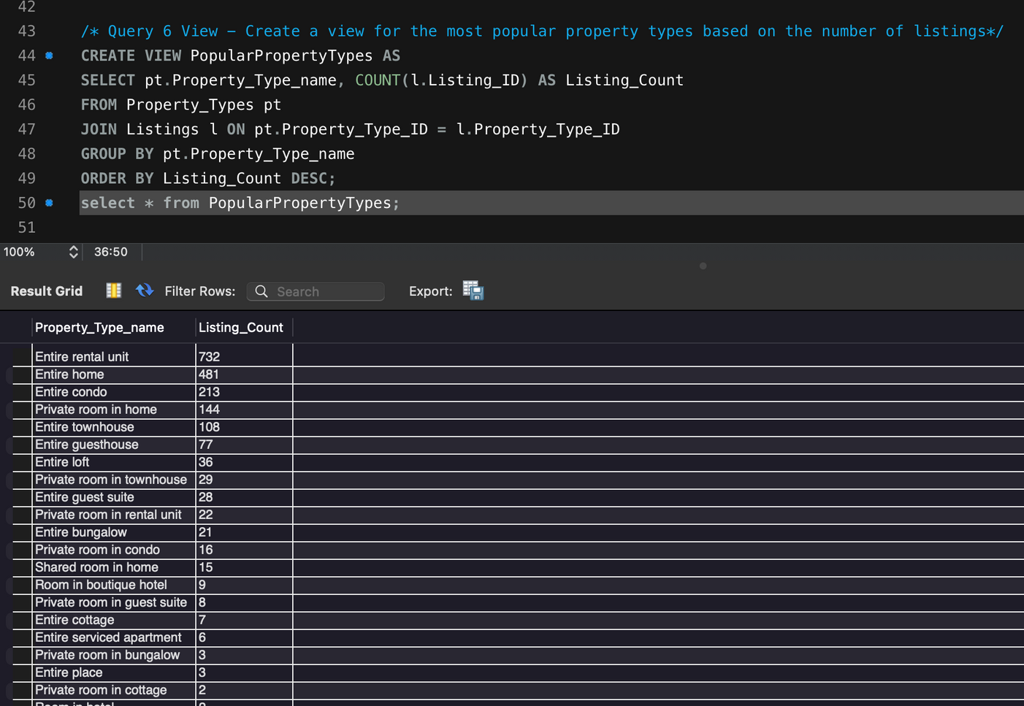
BUSINESS QUESTION 6
What are the most popular property types and their listing counts?

Slide 13
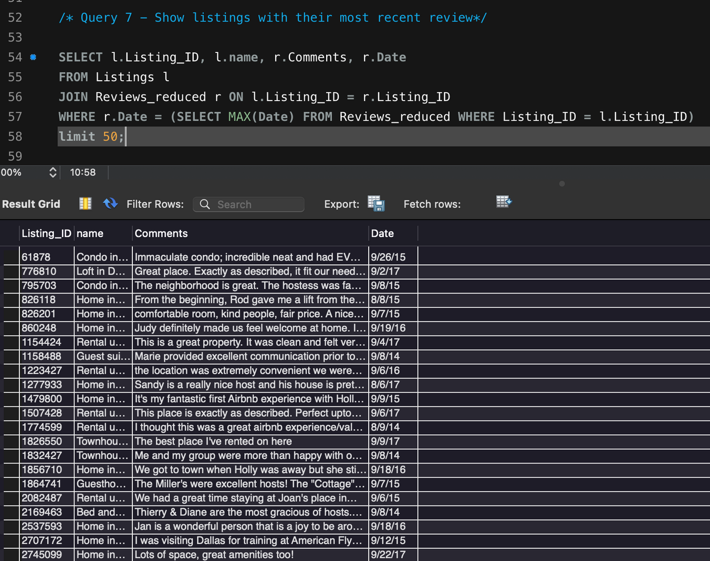
BUSINESS QUESTION 7
Display the latest review for each listing.

Slide 14
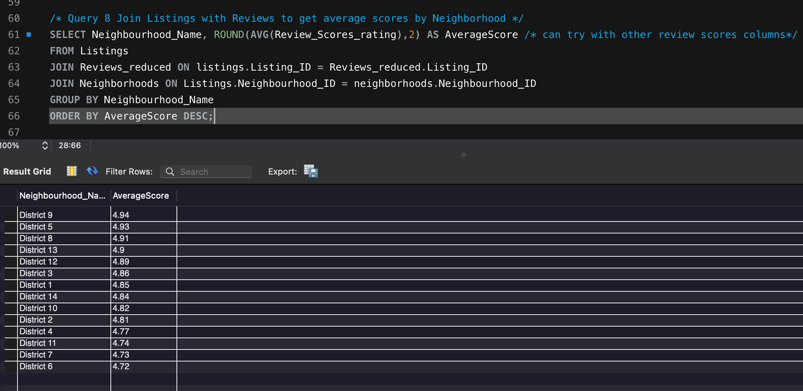
BUSINESS QUESTION 8
What is the average ratings of listings in each neighborhood?

Slide 15
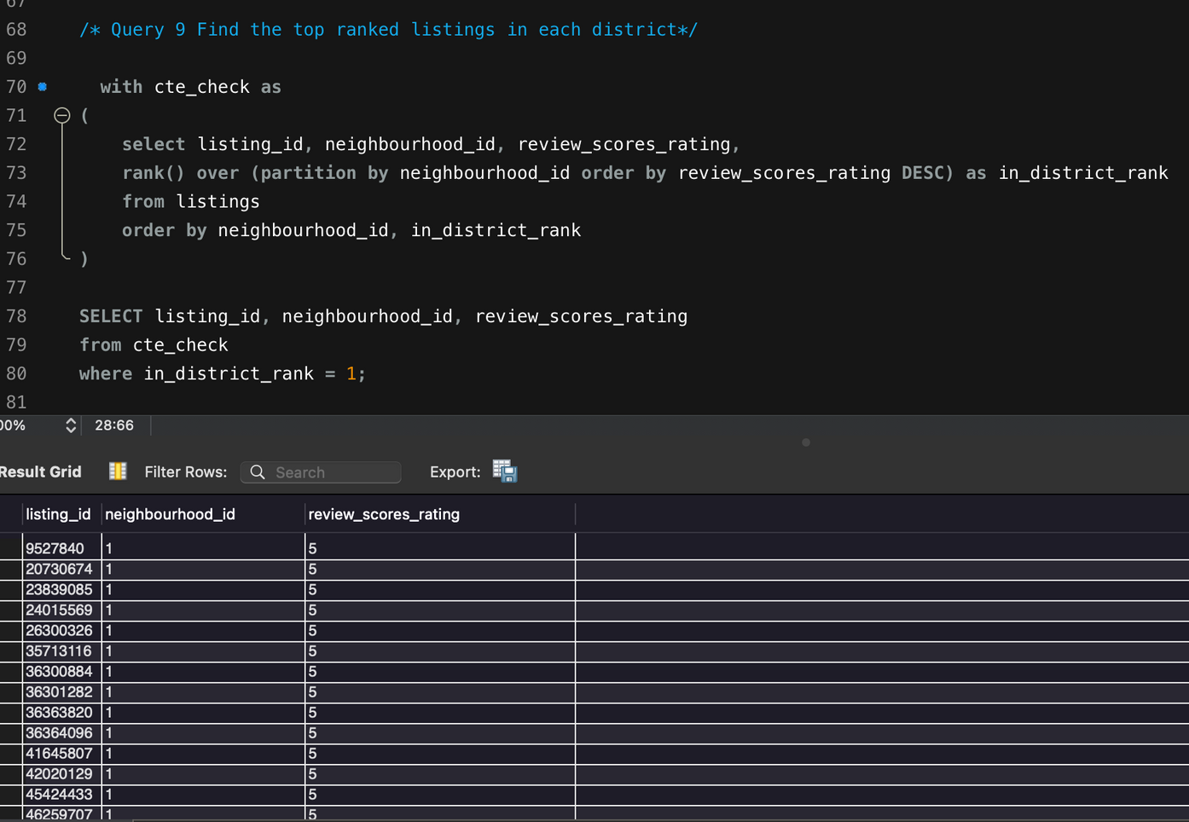
BUSINESS QUESTION 9
Find the top ranked listings in each district.

Slide 16
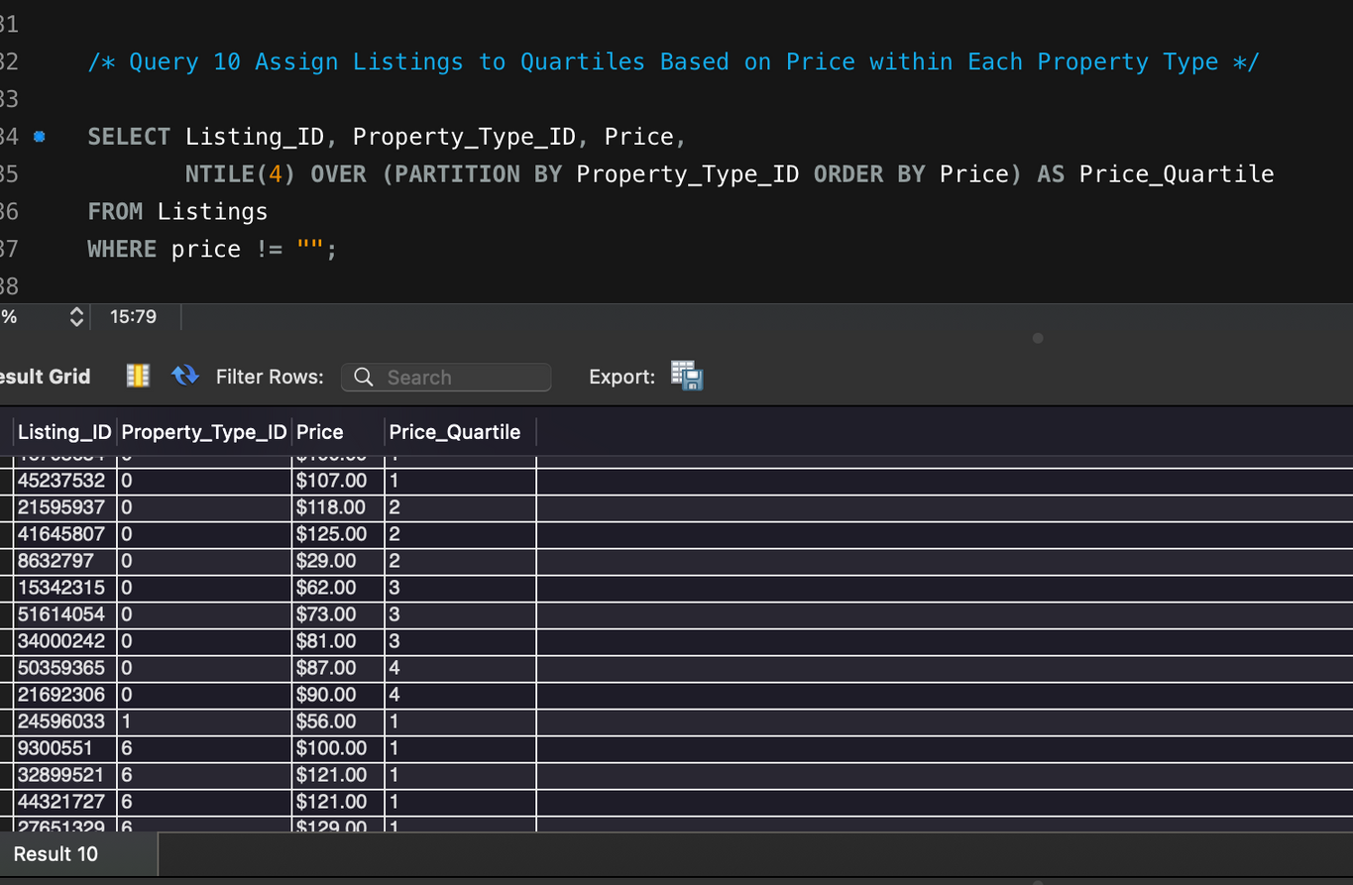
BUSINESS QUESTION 10
Assign Listings to Quartiles Based on Price within Each Property Type

Slide 17
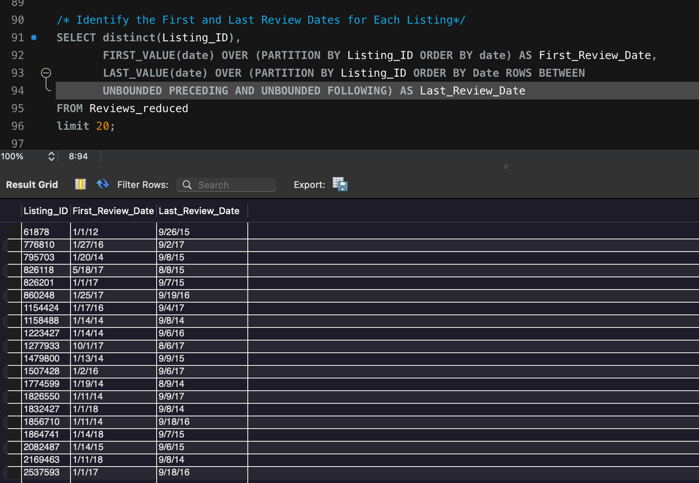
ADDITIONAL EDA QUERIES
First and Last Reviews for each listing

Slide 18
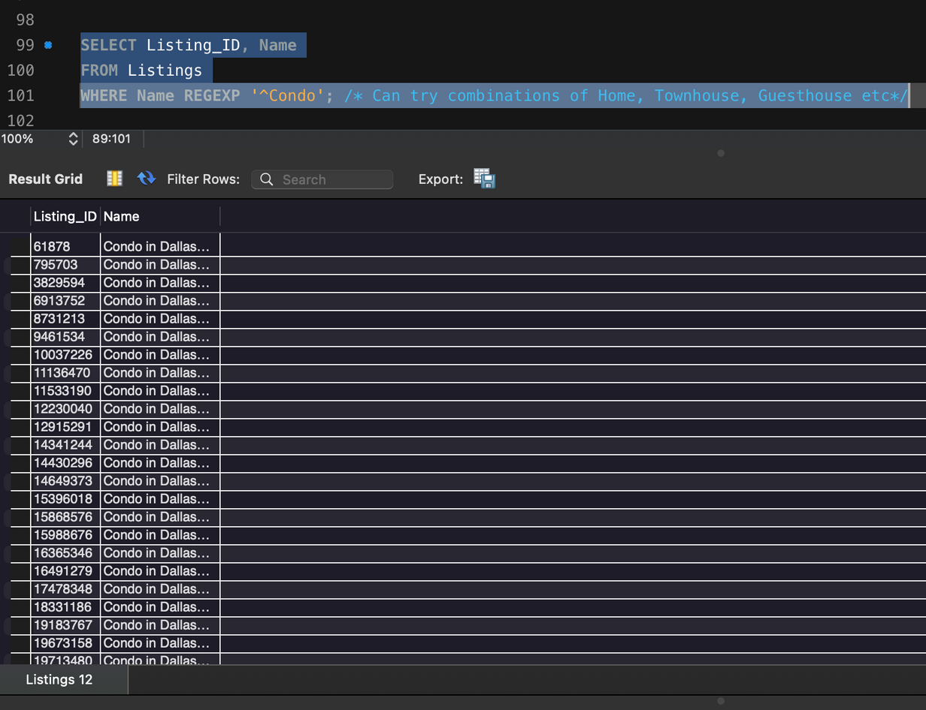
ADDITIONAL EDA QUERIES
Find Listings with name like ‘Condo’

Slide 19

Entire rental units are the most listed property type, suggesting a market preference or higher demand for complete and private accommodations.
The prevalence of entire homes and condos points to a market leaning towards spacious and family-friendly accommodations.
Matt’s position as the top reviewer suggests a high level of engagement and potential influence within the community.
Text Analysis and using function like for keywords “excellent, wonderful, amazing, bad, unsatisfactory” can be used for further sentimental analysis.
Investing in host training and support can significantly enhance the overall experience.
INSIGHTS AND
TRENDS

Slide 20
THANK YOU
QUESTIONS?

